Slide 1




GEOPASTURE
DIGITAL SOLUTIONS FOR AGRICULTURALISTS AND PASTORALISTS

Slide 2

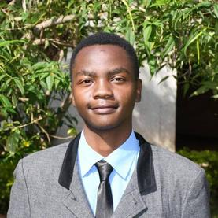


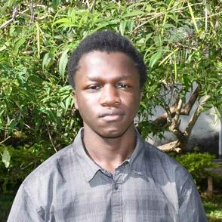

MEET THE TEAM
GET TO KNOW US BETTER
01
04
SAM KELLY
FAITH MOSONIK
Project lead
Backend Developer
05
MELANIE MINAYO
02
JOAN KINOTI
UI/UX Designer
Frontend Developer
MOSES ODENY
06
LYNN NYANDUKO
03
Android Developer
UI/UX Designer

Slide 3
ROADMAP

Slide 4

REPOSITORY CONFIGURATION
GeoPasture
FEBRUARY 17 - FEBRUARY 21
Ensure the repository is properly set up and synchronized with all collaborators. This includes setting up version control, access permissions, branch protection rules, and necessary integrations.
DOCUMENTATION AND COPYRIGHT ACQUISITION
FEBRUARY 24 - FEBRUARY 28
Develop comprehensive project documentation, including technical specifications, user guides, and contribution guidelines. Secure copyright and intellectual property rights as needed to protect project assets.

Slide 5

MOBILE APP DEVELOPMENT
GeoPasture
MARCH 3 - MARCH 7
DIRECT MESSAGING
Implement user authentication.
Develop one-on-one and group messaging features.
Enable push notifications for new messages.
Ensure end-to-end encryption for security.

Slide 6
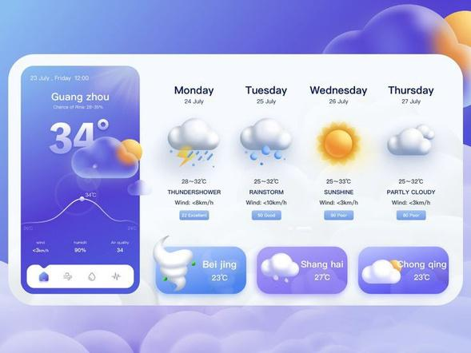
MOBILE APP DEVELOPMENT
GeoPasture
MARCH 10 - MARCH 14
WEATHER FORECASTS
Integrate weather APIs.
Display real-time weather data (temperature, rainfall, wind speed).
Implement weather alerts for extreme conditions.

Slide 7
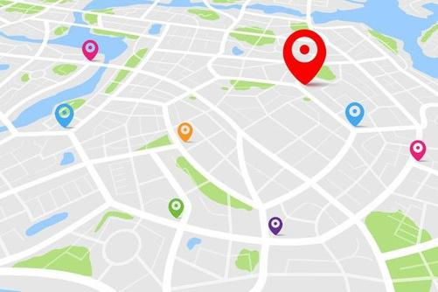
MOBILE APP DEVELOPMENT
GeoPasture
MARCH 17 - MARCH 21
GPS ANIMAL TRACKING
Implement geofencing for animal movement monitoring.
Integrate GPS tracking modules.
Develop real-time animal location display on a map.
Send alerts for boundary breaches.

Slide 8
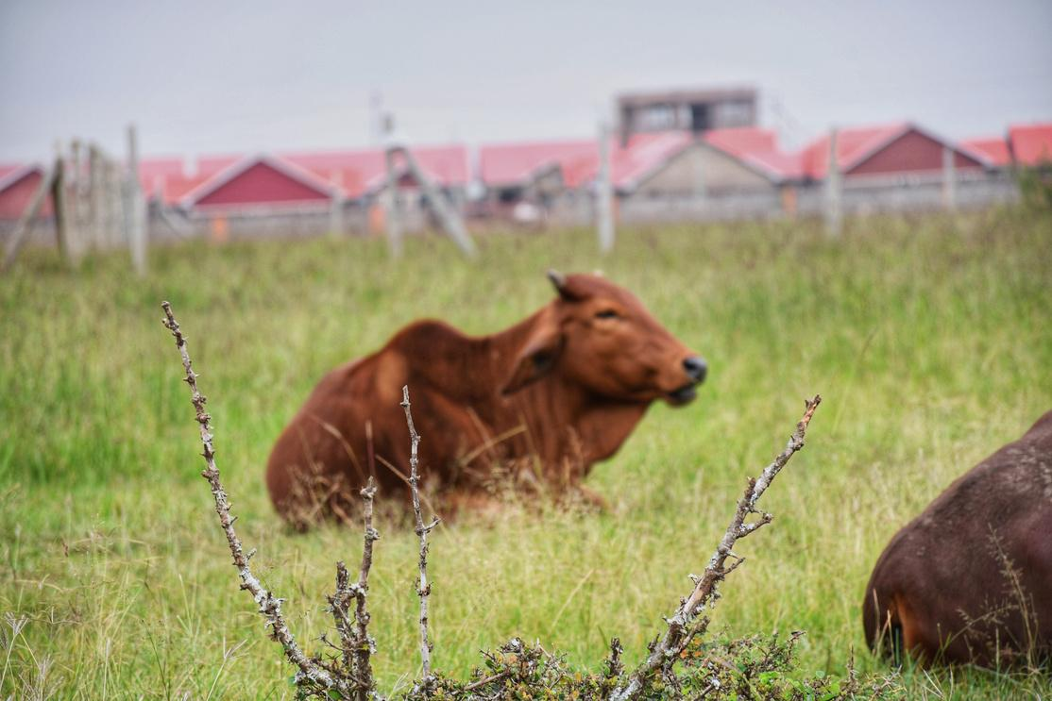
MOBILE APP DEVELOPMENT
GeoPasture
MARCH 24 - MARCH 28
REALTIME PASTURE UPDATES
Utilize satellite imagery APIs.
Enable crowd-sourced pasture updates by users.
Provide a heatmap view of pasture conditions.
Implement AI-driven pasture quality predictions.

Slide 9
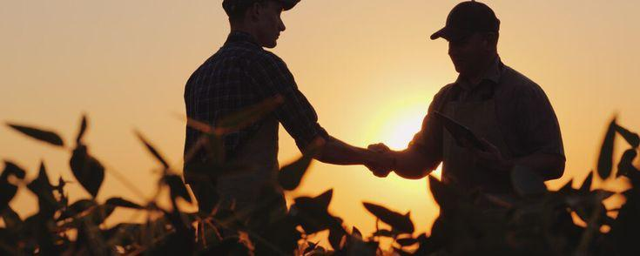
MOBILE APP DEVELOPMENT
GeoPasture
MARCH 31 - APRIL 4
MARKETING PLATFORM
Develop a marketplace module for selling/buying animals and farm produce.
Implement a product listing system with images, prices, and descriptions.
Enable in-app payments (M-Pesa, PayPal, Stripe).
Add buyer-seller chat functionality.

Slide 10

APP DEPLOYMENT
APRIL 7 - APRIL 11
GeoPasture
The app will be made available for use after the development process is done

Slide 11
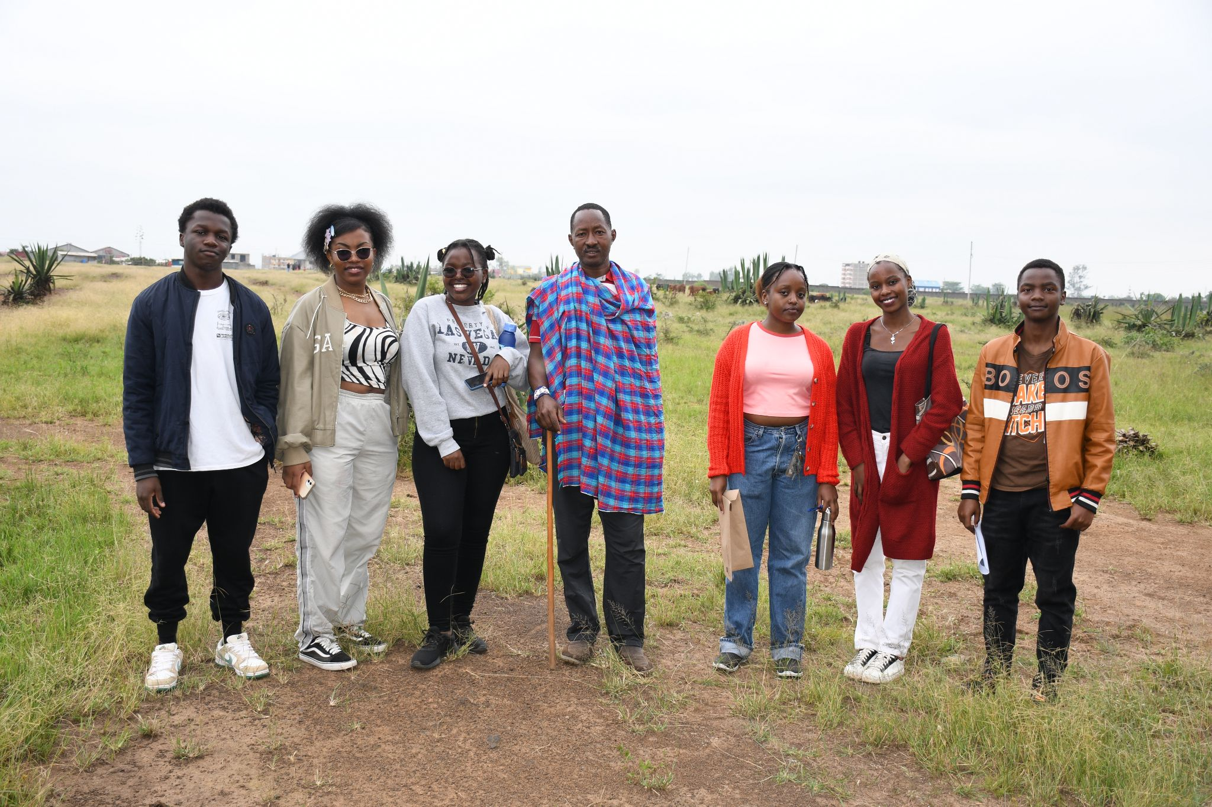
FIELD TRIP(APP TESTING)
GeoPasture
The group will go on a field trip to Lokichogio in order to test the app with the locals since the area is an agricultural area where most people practice crop farming and pastoralism

Slide 12
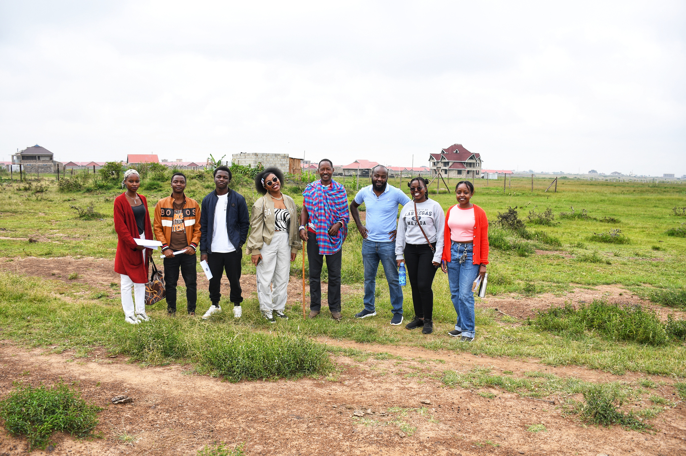

GeoPasture
THANK YOU!

